Slide 1
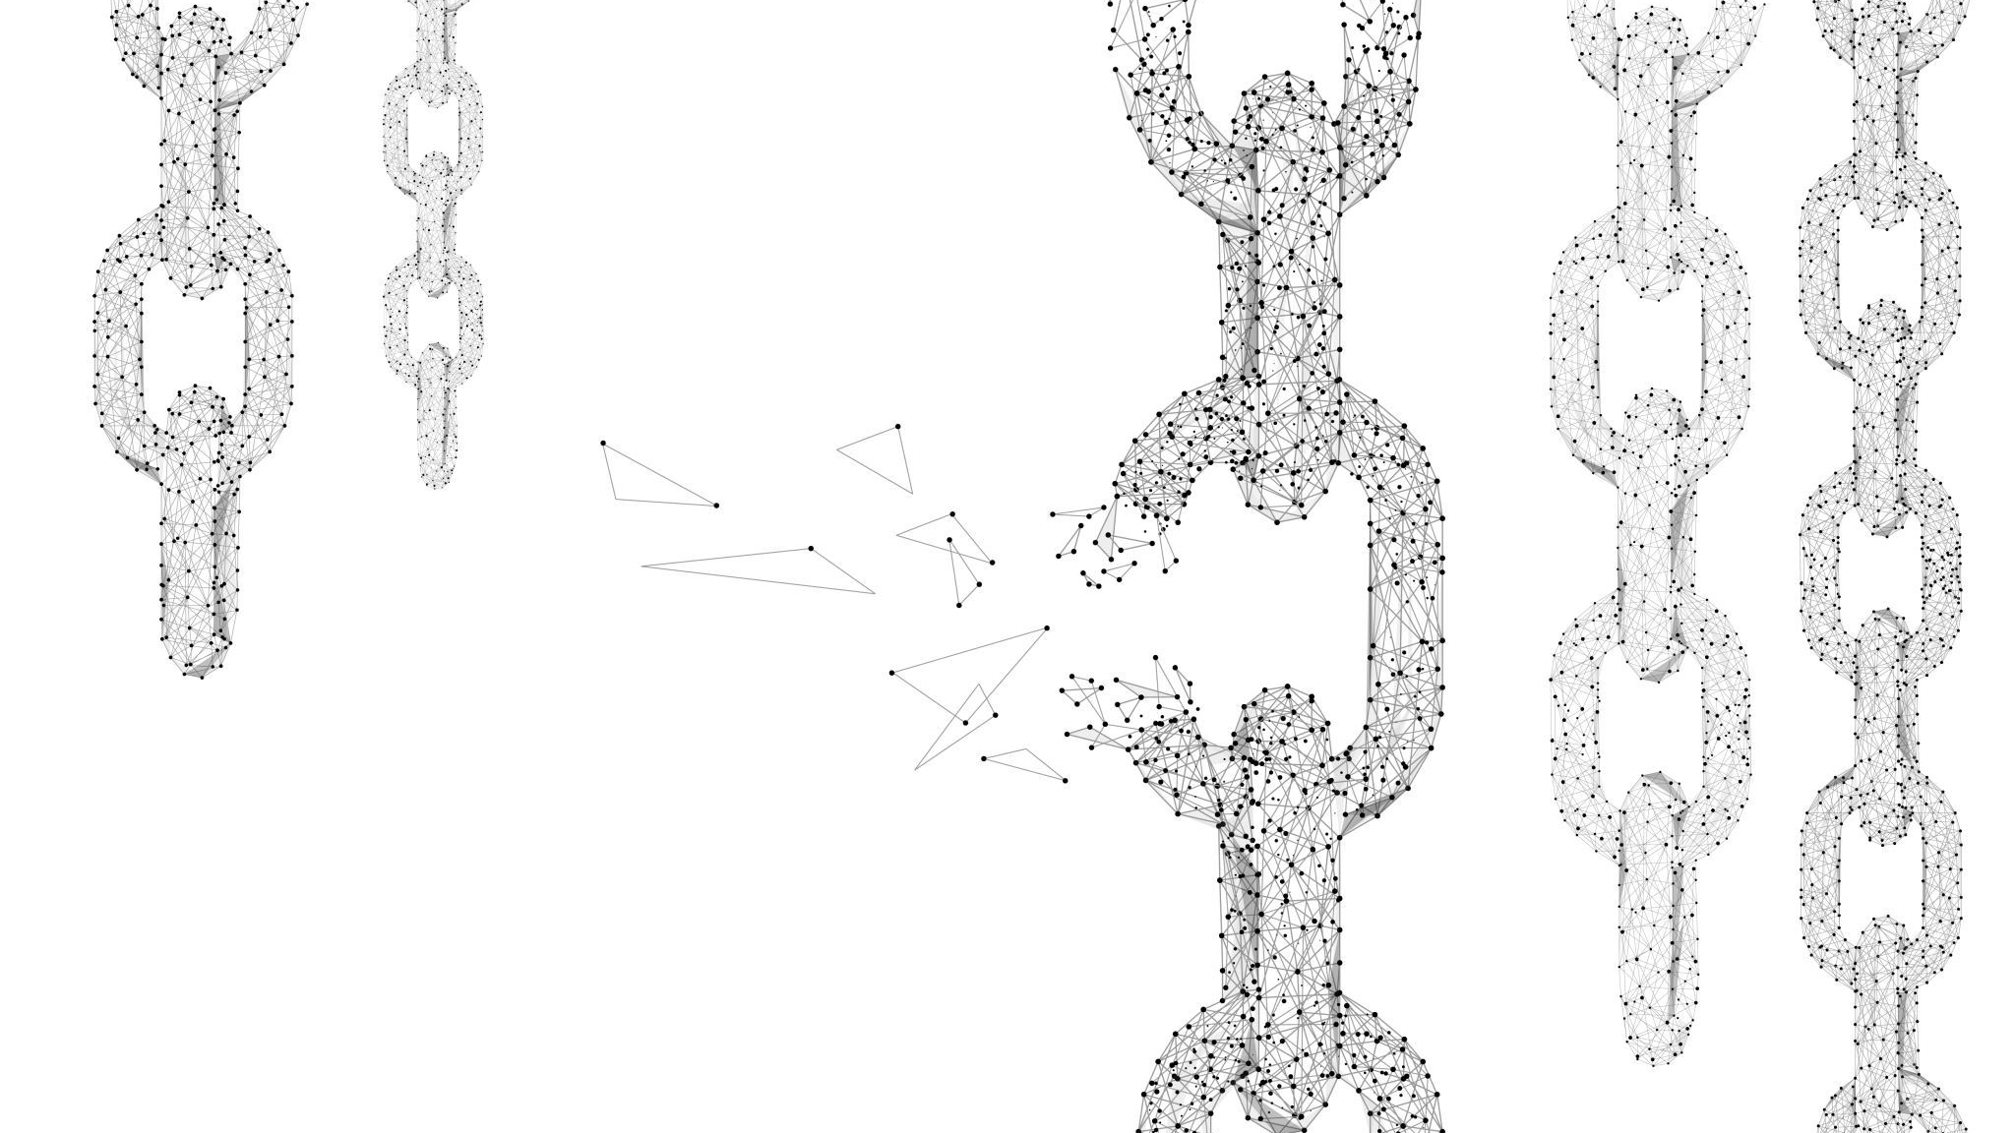
Blockchains
Samuel Itauma
Version 2

Slide 2
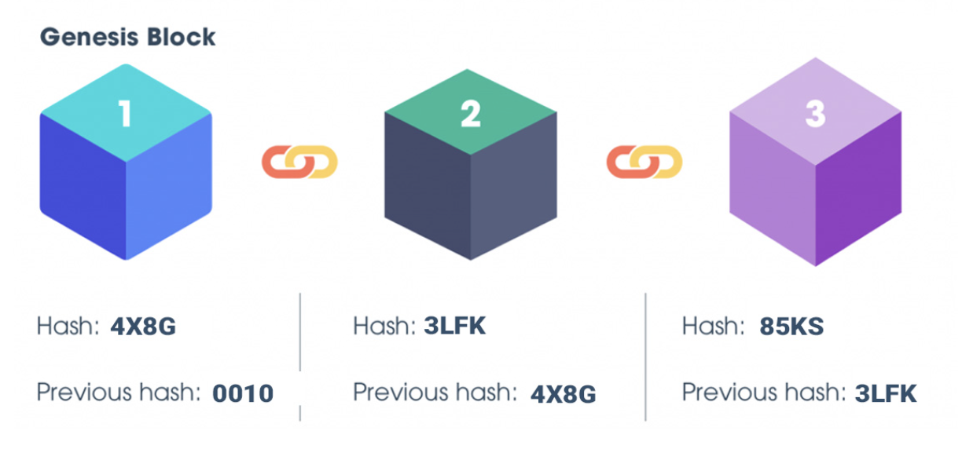
What is Blockchain?
In each of these Blocks Data is stored here. Whether its details about a transaction or Storage data
Just like what the name infers, the Blockchain is a chain of 'Data' blocks immutably linked together.
Yes Data! Its not just used for Crypto Currenies but can carry all sorts of Data types within each block. It just all depends on the Blockchain Platform you use.

Slide 3
QUICK ROWN DOWN OF WHAT WE WILL COVER
Blockchain Networks which are available
Blockchain Data that can be stored
Blockchain Platforms that can be used
Costs which can be expected to occur when using Blockchain Technology

Slide 4
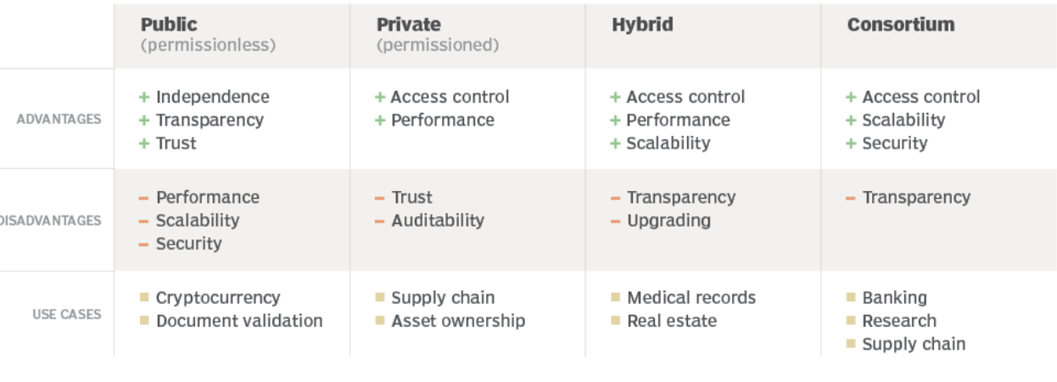
Blockchain Networks
Firstly before we get into the Blockchain Platforms and Data that are avaliable. Lets first understand what each Blockchain Network is.
-Blockchain Network is essentially the Foundation of which a Company would build their Platform on.
-4 CATEGORIES: PUBLIC, PRIVATE, HYBRID AND CONSORTIUM

Slide 5
Data Types
1(PPHC)-Transaction Data – Financial transactions that may include details about a sender, recipient, amount and timestamp.
2(PPHC)-Smart Contract – Contracts that self-execute when the initial terms/agreements are met.
3(PPHC)-Cryptocurrencies
4(PPHC)-Tokenized Assets – Assets like real estate, art, or other physical and digital assets can be tokenized.
5(PPHC)-Immutable Records – Once records are added into a public blockchain it cannot be altered or deleted as it would create the whole chain false. Therefore, historical data is preserved all the way.
6(PPHC)-Identity and Authentication Data – Identity related information can be stored. Users can prove ownership of their digital identities without relying on a central authority.
7(PPHC)-Supply Chain Info – This could be tracking the production, shipment, and delivery of products in a supply chain.
8(PHC)-Sensitive Business Data – Store sensitive business data, such as financial records, property records (recording and storing property rights), supply chain information, or proprietary information relevant to the participants in the network.
9(PHC)-Regulatory Compliance Data – Records may be store here to prove a company is meeting legal requirements or industry standards.
10(PHC)-Internal Processes and Workflows – Imagine a private blockchain as a special digital communication space for a company. Users can use it to manage projects, share documents, and communicate. It's like having a secure and organized online space for getting work done within the company.
11(PPHC)-Operational Data – Details about how much inventory (products or supplies) is available, how well different parts of the company are performing, or any other data.

Slide 6
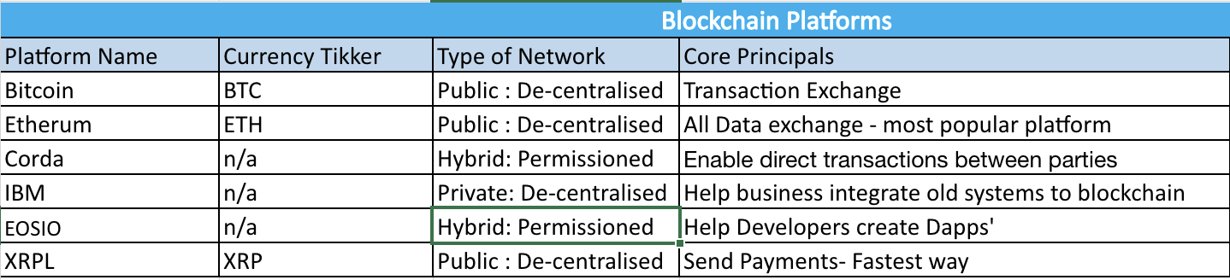
Blockchain Platforms
These are just some of the Blockchain Platforms which are availiable.

Slide 7
Potential Costs
Development and Implementation Costs
Infrastructure Costs
Training and Education
Security and Auditing
Scalability Considerations
Regulatory and Compliance Costs

Slide 8
Thoughts
Summary: The blockchain is a revolutionary system for securely recording transactions, but it still suffers from one major flaw secrecy.
1- Automation
2- Data intergrity: Iot devices (Where did the data come from?, is the data good?)
3-Supply chain: Retail Business (Checking and securing the product transfer process)

